Slide 1

Ngan Dinh
12/15/2021

Slide 2
Demo Projects by Ngan Dinh
Project 1 | Project 2 | Project 3
Sales Report | Stock Dashboard | Extract Data
SSRS SSDT AWS | Power BI Power BI Dashboard Github | Python Jupyter Google Colaboratory
http://ngan.s3-website-us-east-1.amazonaws.com/# | https://ngandinh.github.io/stock/ | https://colab.research.google.com/drive/15BtIzOrdiTNBVsKRed5fzVl-Kel977GX

Slide 3
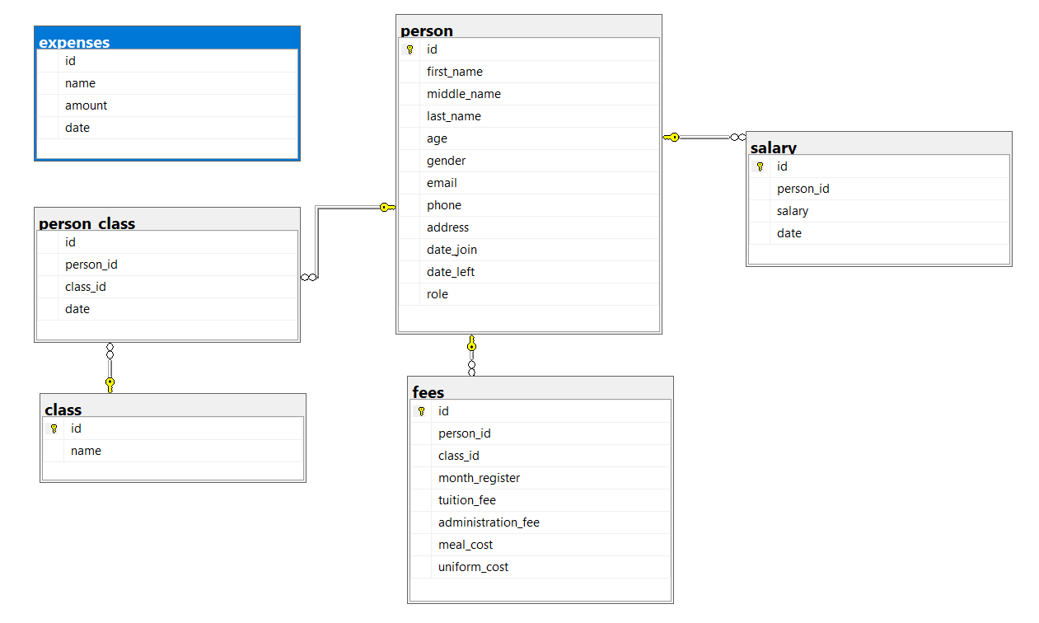
Database Design for A Kingdergarten

Slide 4
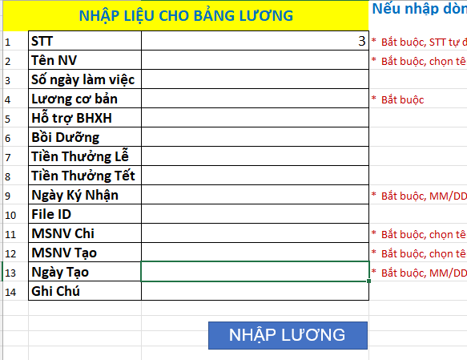
Excel Macro to for Salary System
C:\Users\ngand\Desktop\Khanh-Minh-Kinderganten

Slide 5
Thank you!!!
Prototype Applications:
Cforum Project
http://softunify.com/CForum/
DealPost Project
http://softunify.com/DealPost/index.jsf
MyRealty Project
http://softunify.com/MyRealty/index.jsf

